Slide 1

Interpreter
Compiler

Slide 2
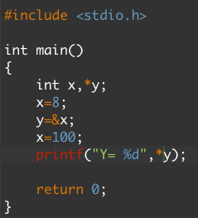

/in/pcakhilnadh

Slide 3
x
8
Ox6745
y
x
100
Ox6745
Output : Y= 100
/in/pcakhilnadh

Slide 4
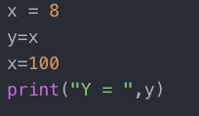
/in/pcakhilnadh

Slide 5
Output : Y= 100
Output : Y= 8
WHY ?
/in/pcakhilnadh

Slide 6

Welcome to the World of Python Programming
Akhil Nadh PC

Slide 7
Contents
Introduction
Data Types
Iterative Statements
Functions
Modules
Coding Question
Conclusion
Introduction To Python Programming
/in/pcakhilnadh

Slide 8
Before We Get Started
Fork the Repository
https://goo.gl/6wcQKU OR
https://github.com/itzpc/Introduction-To-Python-Programming
Introduction To Python Programming
/in/pcakhilnadh

Slide 9
Introduction To Python Programming
/in/pcakhilnadh

Slide 10
Introduction To Python Programming
/in/pcakhilnadh

Slide 11
Introduction To Python Programming
/in/pcakhilnadh

Slide 12
Introduction To Python Programming
/in/pcakhilnadh

Slide 13
Introduction To Python Programming
/in/pcakhilnadh

